Slide 1
Golf Course Mapping
Or mapping for the renderer

Slide 2
Rendering
We are are going to look map a golf course
For the Renderer

Slide 3
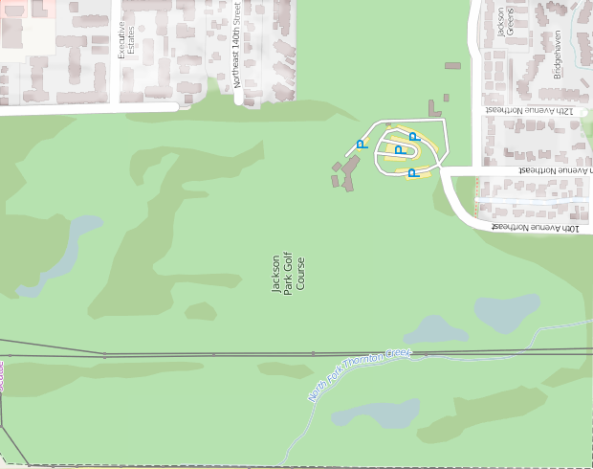
Jackson Park Golf Course

